Slide 1


Developing An Ensemble Model to Predict the Effect of Heat Waves
Nitish Maity, Dr. Gaurav Kumar Yadav
Department of Computer Science and Engineering,
Institute of Technical Education and Research,
Siksha 'O' Anusandhan University, Bhubaneswar, Odisha

Slide 2
Paper Outline
1. Introduction
2. Motivation
3. Related Work
4. Data collection And Processing
5. Dataset
6. Methodology
7. Model Evaluation
8. Model Interpretation and Statistical Methods
9. Results and Analysis

Slide 3

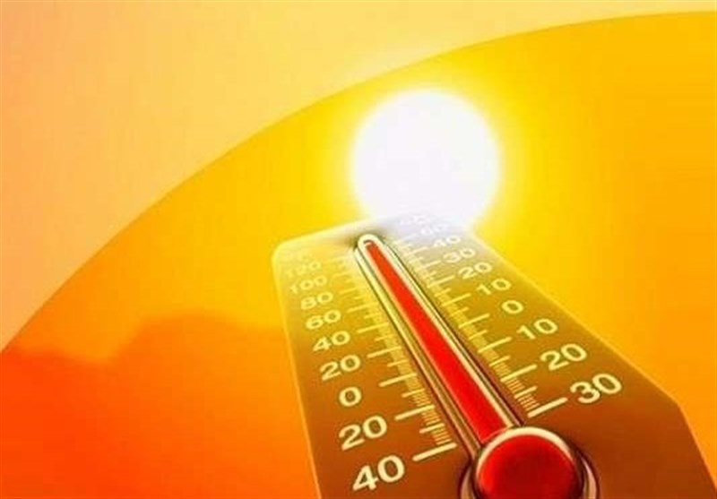
Introduction
1
Overview of Heat Waves
Heat waves are prolonged periods of excessively hot weather, often with high humidity, and are becoming more frequent and severe due to climate change.
2
Objective
Develop an ensemble model to predict the impact of heat waves in Odisha, focusing on the correlation between meteorological factors and heat wave fatalities.

Slide 4


Motivation
Importance of Prediction
Accurate prediction of heat waves is crucial due to significant health risks.
Odisha's Vulnerability
Odisha has been experiencing increasing intensity and frequency of heat waves, leading to higher mortality rates.

Slide 5
Related Work
Previous Research
Gaps in Existing Studies
Previous research utilized Rough Set Theory and Support Vector Machine for accurate heatwave predictions, improving forecasting methods. This work analyzed weather and health data to establish correlations, aiding in the development of mitigation strategies.
Existing studies have limited predictive accuracy and
often lack comprehensive datasets that include both
detailed weather and health data for robust heatwave
impact analysis.

Slide 6
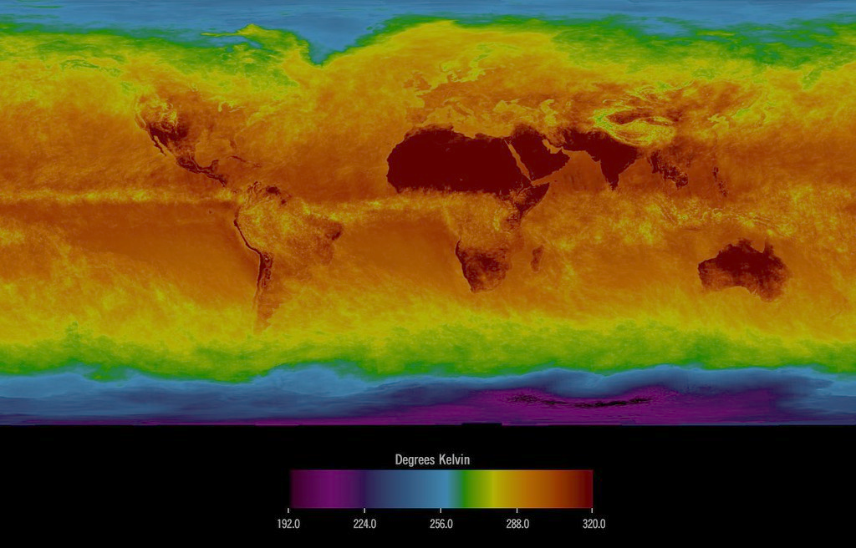
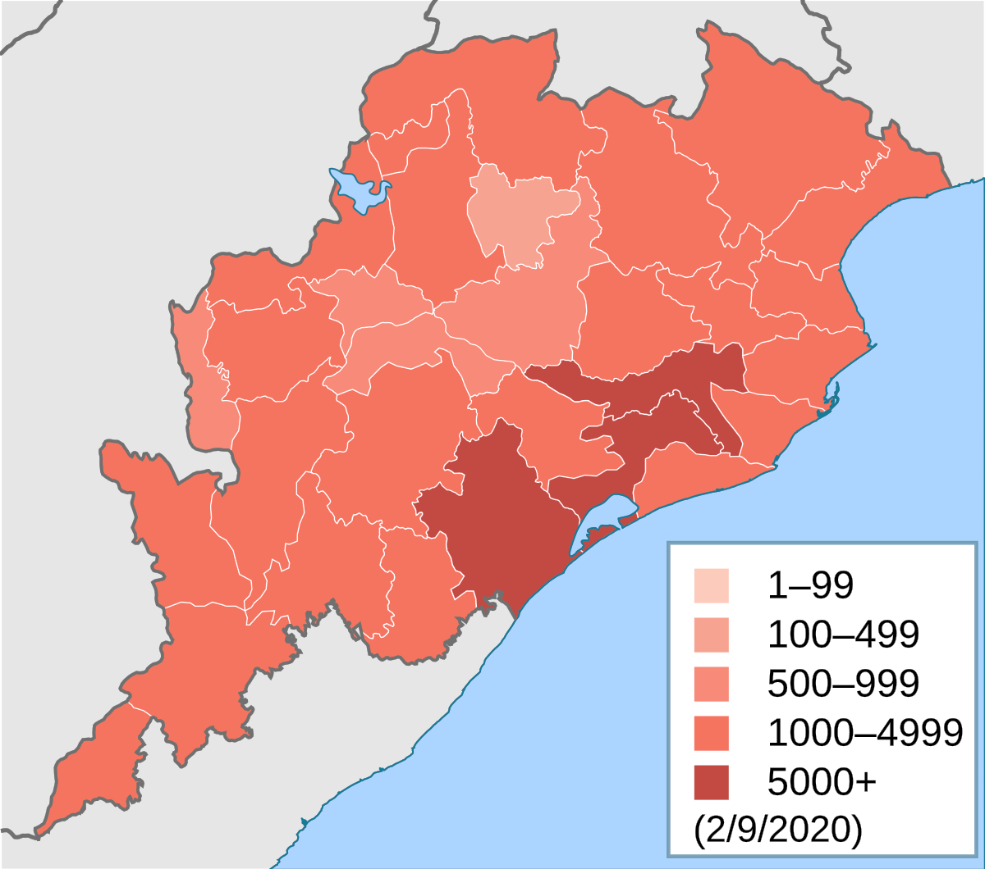
Data Collection and Preprocessing
1
Data Sources
Indian Meteorological Department (IMD), Local health departments.
2
Types of Data
Daily records of temperature, humidity, air pressure, wind speed, and heat wave-related deaths.
3
Data Preprocessing
Handling missing values, outlier detection, standardization, addressing class imbalance.

Slide 7
Dataset
PLACE | DATE | TEMP | PRESSURE | HUMIDITY | WIND | PREC | AFFECTED
Balasore | 15-4-2024 | 40 | 1012 | 89 | 17 | 0 | 1
Sundargarh | 15-4-2024 | 40 | 1012 | 80 | 9 | 0 | 35
Mayurbhanj | 15-4-2024 | 39 | 1011 | 93 | 6 | 0 | 7
Angul | 15-4-2024 | 40 | 1012 | 89 | 17 | 0 | 7
Balangir | 3-6-2024 | 38 | 1001 | 48 | 6 | 1.6 | 13

Slide 8

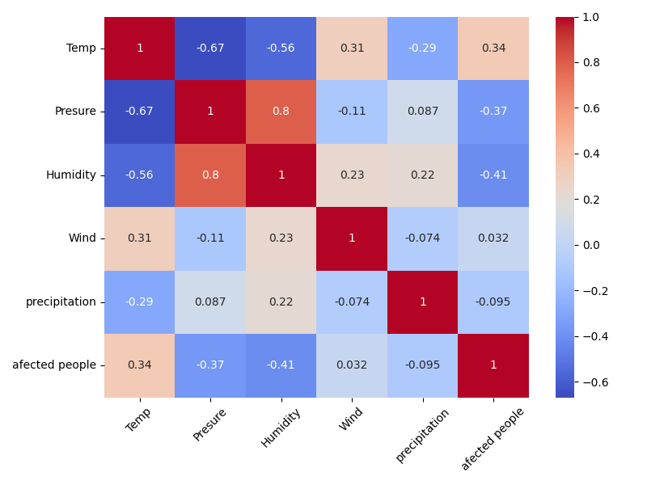
Methodology
1
Base Level
Multiple linear regression, ridge regression, and support vector regressor (SVR).
2
Meta Level
Fully connected neural network.
3
Model Training
Data preprocessing, handling class imbalance, training base models, and combining them using a meta-level neural network.

Slide 9
Model Evaluation
R-squared (R²):
Decision tree: 0.21
Random Forest: 0.44
Ada Boost: 0.85
Mean Absolute Error (MAE):
Decision tree: 3.91
Random Forest: 5.6
Ada Boost: 2.57
Root Mean Square Error (RMSE):
Decision tree: 8.7
Random Forest: 7.3
Ada Boost: 3.81
Performance Metrics
(R²) for variance explanation, (RMSE) for prediction accuracy, (MAE) for quantifing average prediction error magnitude.
Preliminary Results
AdaBoost outperformed other models with highest R² and
lowest MAE, RMSE.

Slide 10





Model Interpretation and Statistical Methods
Air Pressure
Data Preprocessing
Z-score Normalization
SMOGN
Regression Techniques
Linear Regression
Ridge Regression
Lasso Regression
Elastic Net
Evaluation Metrics
R-squared (R²)
Root Mean Square Error (RMSE)
Mean Absolute Error (MAE)
Temperature
Humidity
Wind speed
Affected people

Slide 11
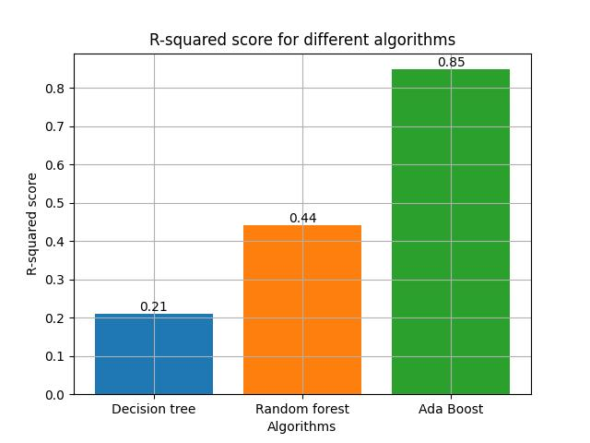

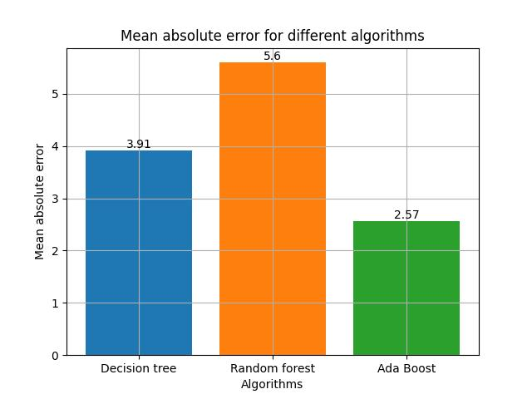
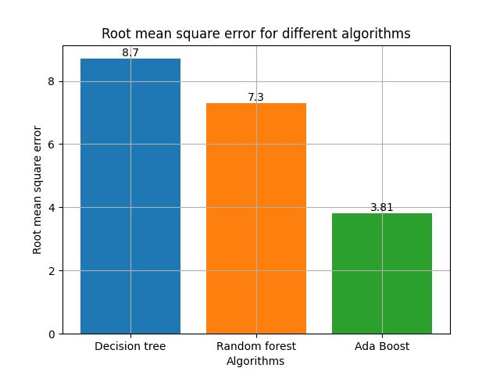
Results and Analysis
Qualitative Results
Descriptive interpretation of findings.
Quantitative Results
Numerical insights and model performance metrics.
Correlation Analysis
Heatmap illustrating relationships between variables.

Slide 12

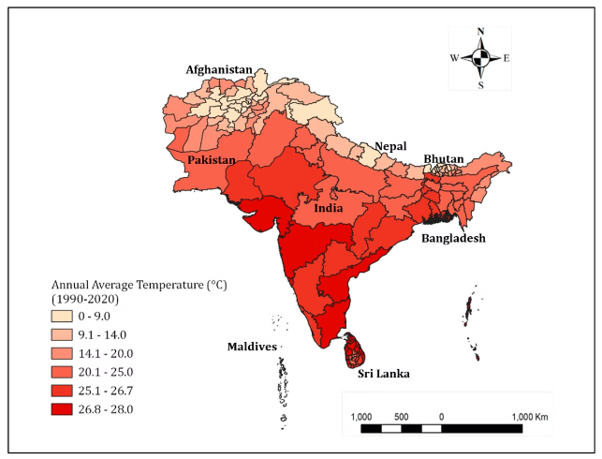


Conclusion
Summary of Findings
High accuracy of the ensemble model in predicting heat wave fatalities. Significant roles of air pressure, temperature, and humidity.
Future Directions
Enhancing model accuracy with more data, expanding the model to other regions and climate phenomena.

Slide 13
Thank You
Hope This Presentation Was Knowledgeable

